Slide 1

Design and Simulation of a 4-Bit Binary Arithmetic Calculator Using Combinational Logic
Student Name | Roll Number · Department of CSE/ECE | College Name-KLH UNIVERSITY
VARSHA BINDHU-2620030012
JAGRITHI-2620030027
SAGAR REDDY-2620030055
SASANK RAHUL-2620030099
UNDER GUIDANCE: DR.RAHUL SIR

Slide 2

Introduction: Digital Arithmetic
Digital Arithmetic
The foundation of all computational systems — every modern device relies on arithmetic at its core.
Binary Calculations
The core language of modern processors — all data is ultimately represented as 1s and 0s.
Arithmetic Circuits
Enable fast, efficient computation in CPUs and embedded systems through combinational logic.

Slide 3

Problem Statement
1
Manual Binary Calculations Are Slow
Human-performed binary arithmetic is inherently slow and highly susceptible to errors in complex computations.
2
Need for Automated Computation
Digital systems demand fast, automated arithmetic that can operate at clock speeds far beyond human capability.
3
Efficient Circuit Design is Essential
Combinational logic circuits are the backbone of processor design — efficiency here directly impacts system performance.

Slide 4
Project Objectives
Design
Implement
Design a 4-bit Arithmetic Calculator using combinational logic circuits
Implement Addition, Subtraction, Increment, and Decrement operations
Simulate
Analyze
Simulate and verify all outputs using Logisim simulation software
Analyze performance metrics and evaluate hardware efficiency

Slide 5

System Overview
Inputs
A(4 bits), B(4 bits), S1 S0
Three-stage Data Flow
Output
Processing
4-bit result plus carry flag
Combinational logic selects operation
The calculator accepts two 4-bit operands and two selection lines, routes them through combinational logic, and produces a verified 4-bit result with carry flag — all without any clock or memory element.

Slide 6

Key Components
Full Adder
Adds three bits (A, B, C) in and produces Sum and Cout — the fundamental building block of the calculator.
XOR Gates
Enable 2's complement conversion, making subtraction possible using the same adder hardware.
Multiplexer
Selects the correct operation output based on control lines S1 and S0.
Logic Gates
AND, OR, and NOT gates manage control signals and data flow throughout the circuit.

Slide 7
Arithmetic Operations
Addition
Subtraction
S1=0, S0=0
Computes A + B directly using the ripple carry adder chain
S1=0, S0=1
Computes A − B using 2's complement of B with XOR inversion
Increment
Decrement
S1=1, S0=0
Computes A + 1 by adding a forced carry-in of 1
S1=1, S0=1
Computes A − 1 using 2's complement subtraction by one

Slide 8

Operation Selection Table
S1
S0
Operation
0
0
Addition — A + B
The two selection lines S1 and S0 fully determine which arithmetic operation the combinational circuit performs. This 2-bit control code maps directly to four distinct operations.
0
1
Subtraction — A − B
1
0
Increment — A + 1
1
1
Decrement — A − 1
Only 2 control bits are needed to select from all 4 operations — a hallmark of efficient combinational design.

Slide 9

Circuit Architecture
Ripple Carry Adder
4-bit RCA chains four full adders, propagating carry across bits for addition operations
XOR for 2's Complement
XOR gates invert B bits; Cin=1 completes 2's complement for subtraction
Multiplexer Output
MUX routes the correct computed result to the output bus based on S1, S0
Carry & Overflow Flags
Carry-out and overflow flags validate results and detect boundary conditions

Slide 10
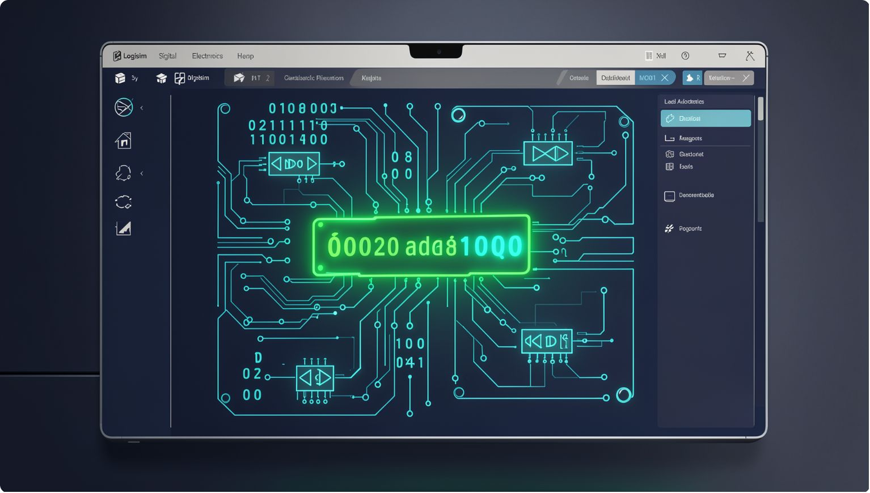

Simulation Results
All four operations verified in Logisim — each producing correct binary output matching expected decimal results:
Operation
Binary
Decimal
Addition
0101 + 0011
5 + 3 = 8
Subtraction
1001 − 0011
9 − 3 = 6
Increment
0111 + 0001
7 + 1 = 8
Decrement
1000 − 0001
8 − 1 = 7
All simulation outputs verified correct — zero discrepancies between expected and simulated results.

Slide 11
Advantages, Applications & Conclusion
Advantages
✅ Achievements
🚀 Future Work
Fast, gate-level computation with no clock dependency
Simple, low hardware complexity design
Fully expandable to wider bit-widths
Designed and simulated a fully functional 4-bit arithmetic calculator with verified combinational logic.
Expand to 8-bit, add multiplication & division, and deploy on FPGA hardware for real-world validation.
Applications
ALU design in general-purpose processors
Digital computers and embedded systems
Signal processing and FPGA implementations
🙏 Thank You
Questions & Answers — we welcome your feedback and discussion.

Slide 12
Thank You
We appreciate your time and attention to our project. We hope our work demonstrates a clear understanding of combinational logic design and its practical application in digital arithmetic.

